Slide 1
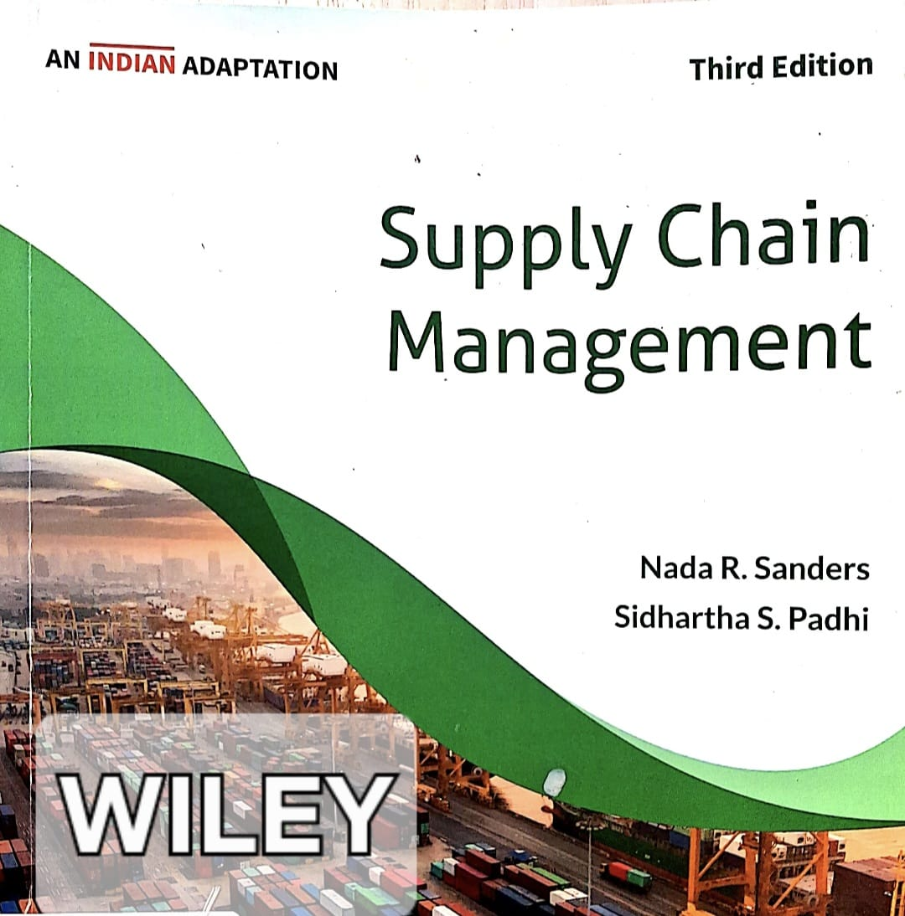
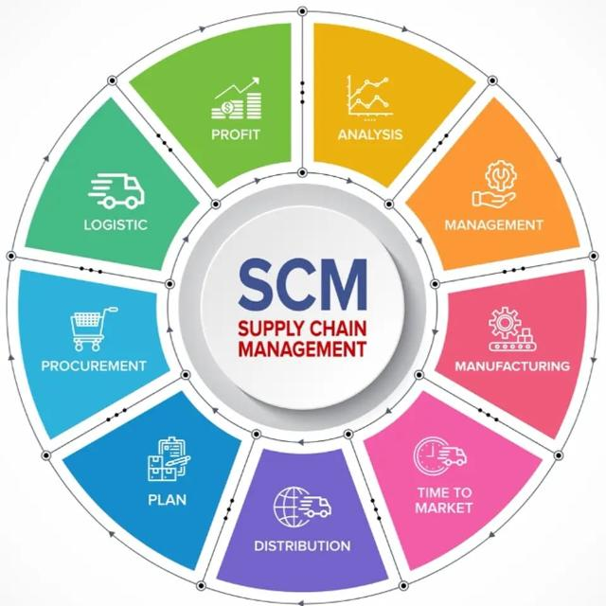

Slide 2
SUBJECT: SUPPLY CHAIN MANAGEMENT STRATEGY
CHAPTER: 01
CHAPTER TITLE: INTRODUCTION TO SUPPLY CHAIN MANAGEMENT
REFERENCE BOOK:
SUPPLY CHAIN MANAGEMENT (AN INDIAN ADAPTATION), N R SANDERS & S S PADHI, WILEY, 3RD ED. (2023)

Slide 3
KEY CONCEPTS
Supply chain | The network of all entities involved in producing and delivering a finished product to the final customer, including sourcing raw materials and parts, manufacturing, producing, and assembling the products, storing goods in warehouses, order entry and tracking, distribution, and delivery to the final customer.
Supply chain management (SCM) | The design and management of flows of products, information, and funds throughout the supply chain.
Manufacturing Supply chain | The supply chain (network of all entities) that involved in producing and delivering a tangible product.
Service supply chain | The supply chain that focuses more on the interaction between the customer and provider, in which the provider typically interacts directly with customers, without the buffer of retailers and distributors, enabling easier information sharing. In service organisations, the customer is the supplier of inputs and information, which can change the service delivery. In the legal environment, the course of legal action greatly depends on information provided by the client to their lawyer, and in academic/research environments, it greatly depends on information provided by the student/scholar to their professors.

Slide 4
KEY CONCEPTS
Focal firm | Companies/firms/manufacturers/producers governing over the supply chain.
Suppliers | Those who are supplying goods and services to a firm/manufacturers/producers.
Upstream of the supply chain | The stages of the supply chain that comprise the inbound direction toward the focal firm, comprising all inbound suppliers.
Downstream of the supply chain | The stages of the supply chain that are away (outbound) from the focal firm, comprising distributors/wholesalers and retailers/customers.
First-tier suppliers | Those who are directly supplying goods and services to a firm/manufacturers/producers.
Second-tier suppliers | Those who are supplying goods and services to the first-tier suppliers of a company.
Intra-organizational coordination | SCM that spans and integrates functions and processes within the enterprise
Cross-enterprise coordination | SCM that spans and integrates functions and processes between the enterprises supply chain

Slide 5
KEY CONCEPTS
Sourcing | The function of the enterprise responsible for linking the organisation to its suppliers and ensuring an efficient supply of materials.
Operations | The enterprise's function is to organise the transformation of raw materials into finished products and ensure that the exact products customers want are produced efficiently and cost-effectively.
Marketing | The function of the enterprise responsible for linking the organisation to its customers and identifying what customers want in products and services.
Logistics | The function of the enterprise involves moving and positioning inventory throughout the supply chain, which includes order processing and tracking, inventory management, transportation, warehousing, material handling, and packaging and ensures that the right products are delivered to the right place at the right time.
Reverse logistic | When the direction of product flow is reversed in the chain, i.e., from customer to retailer/wholesaler/manufacturer, due to defective/damaged or obsolete (out of date).

Slide 6
KEY CONCEPTS
Outsourcing | Hiring a third party to perform a set of tasks for a fee
ERP (Enterprise resource planning) | Large software programs used for planning and coordinating all resources throughout the entire enterprise. They allow data sharing and communication within and outside of the firm, enabling collaborative decision making.
GPS (Global positioning systems) | A type of wireless technology that uses satellite transmission to communicate exact locations.
RFID (Radio frequency identification) | A type of wireless technology that uses memory chips equipped with tiny radio antennas that can be attached to objects to transmit streams of data, such as product movement, reveal a missing product’s location, or track shipments and their arrival.
Lean Supply Chain | The set of all organizations directly linked by upstream and downstream flows of products, services, finances, and information that collaboratively work to reduce cost and waste by analyzing processes and identifying areas for improvement

Slide 7
SECTION 1

Slide 8
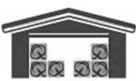

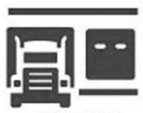

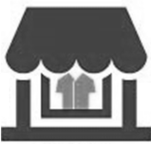

KEY COMPONENTS OF SUPPLY CHAIN
 | SUPPLIERS: Providers of raw materials, component parts, semi-manufactured products and unfinished or non-consumable products.
 | MANUFACTURERS: Makers of final products responsible for final assembly or product integration.
 | DISTRIBUTORS: Responsible for managing, storing and handling products for organisations that don’t want to carry the entire variety of products in their own facilities.
 | LOGISTICS SERVICE PROVIDERS: Commercial provider of individual or multiple integrated service for other entities in the supply chain e.g. transportation management, value-added warehousing and distribution and information technology-based services.
 | RETAILERS: The entity that buys from the manufacturer/wholesaler and sells to the final customer.
 | CONSUMERS: People who go into the stores and buy and consume the product

Slide 9
1. A simple supply chain (Roasted coffee beans)
Upstream
Focal firm
Downstream
Producer /
Manufacturer
of
Roast coffee beans
Wholesaler /
Distributer
of
Roasted coffee beans
Supplier (S1)
of
Coffee beans
Retailer
of
Roasted coffee beans
Customer
of
Roasted coffee beans

Slide 10

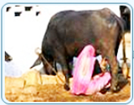
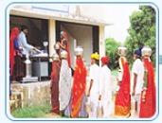
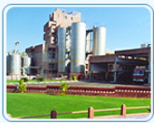
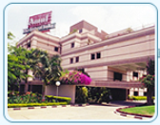
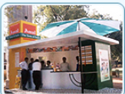
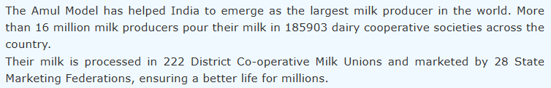
The Amul Model
Village Dairy
Co-op.
(1,85,903)
Dist. Milk
Co-op. Union
(222)
State Co-op. Milk Mktg. Fed.
(28)
Milk producer
(16 million+)
Consumer
Source: https://amul.com/m/about-us retrieved on 22/02/2026

Slide 11
2. A simple supply chain (Wooden Study Table)
Upstream
Focal firm
Downstream
Supplier (S1)
Wood/ply
Producer /
Manufacturer
Wooden Study Table
Supplier (S2)
Steel
Wholesaler
Wooden study tables
Retailer
Wooden study tables
Customer
Wooden study tables
Supplier (S3)
wood adhesive
Supplier (S4)
Screw/ nut & bolts

Slide 12
2. A simple supply chain (Wooden Study Table)
Upstream
Focal firm
Downstream
Supplier (S1)
Wood/ply
Producer /
Manufacturer
Wooden Study Table
Supplier (S2)
Steel
Wholesaler
Wooden study tables
Retailer
Wooden study tables
Customer
Wooden study tables
Supplier (S3)
wood adhesive
Reverse Logistics
(return of defective / damaged product)
Supplier (S4)
Screw/ nut & bolts

Slide 13
3. A simple supply chain (Leather shoes)
Upstream
Focal firm
Downstream
Second-tier suppliers
First-tier suppliers
Producer /
Manufacturer
Leather shoes
S6
Raw leather
Supplier (S1)
Leather hide
S7
Rubber
S2
Rubber soles
Wholesaler /
Distributer
Leather shoes
Retailer
Leather shoes
Customer
Leather shoes
S8
Synthe. fibers
S3
Laces
S9
Chemical
S4
Adhesives
S10
Cardboards
S5
Cartons

Slide 14
SECTION 2

Slide 15
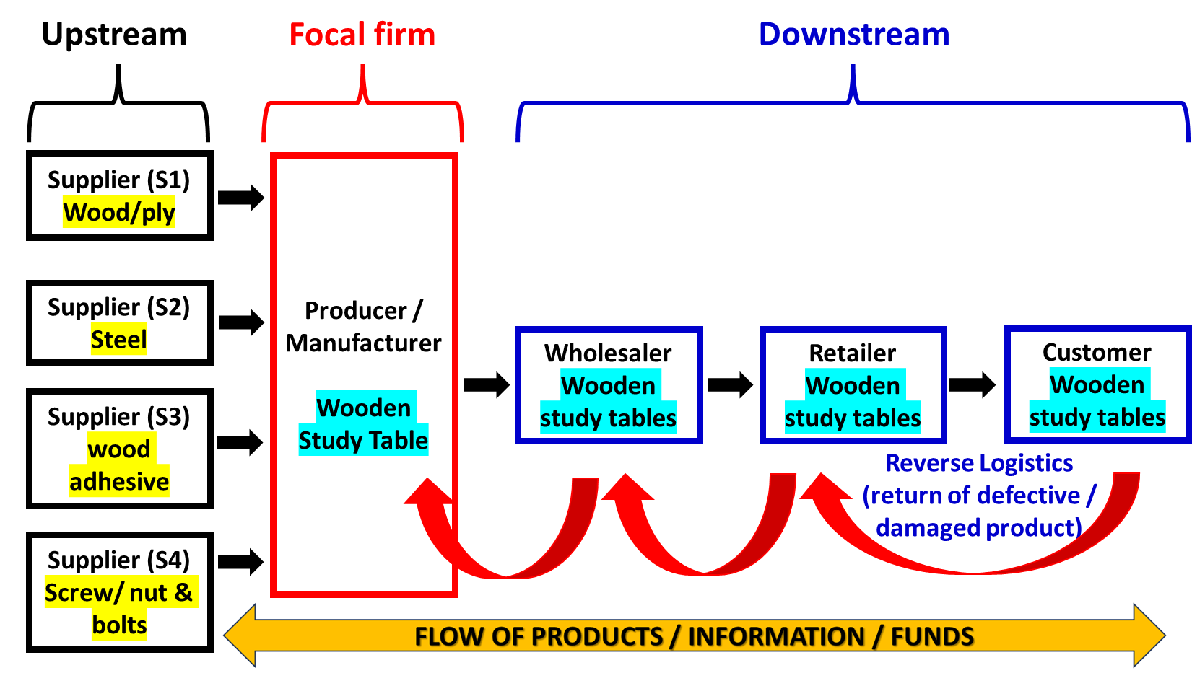
Flow of product, information, & funds through the Supply Chain
Flow of products: Products/goods flow from the beginning of the chain (supplier) through various stages of production to the final customer, and the flow back of goods/products (reverse logistics) that are unacceptable to customers due to defects, damage, or obsolete (out of date).
Flow of information: Real-time sales information transmitted from retailer to wholesaler, producer and supplier reduces uncertainty, and the amount of inventory (stock) carried throughout the supply chain, at each stage.
Flow of funds: Financial flow (money flow from buyer to seller) is often viewed as one-directional, flowing backwards in the supply chain as payment for products and services received. However, as products flow in both directions, so does the transfer of funds.

Slide 16
SCM Activities
SCM involves the coordination and management of all the activities of a supply chain and is responsible for managing the system of flows between the different entities of a supply chain in order to satisfy the final customer and maximize total supply chain profitability. SCM activities include (i) coordination, (ii) information sharing, and (iii) collaboration.
SCM coordinates the movement of goods and services through the supply chain, from suppliers to manufacturers to distributors to final customers, including the movement of goods back up the supply chain as products may be returned due to defect or damage. It also coordinates the movement of funds through the supply chain as products are purchased and sold.
SCM involves information sharing among members of the supply chain, including demand and sales forecasts, point-of-sale data, promotional campaigns planned, and inventory levels.
SCM involves collaboration between supply chain members so that they jointly plan, operate, and execute business decisions such as product design and process improvement to implement business initiatives or follow a particular business strategy as one entity.

Slide 17
SECTION 3

Slide 18
Challenges of SCM
Bullwhip effect: If information sharing between different stages of the Supply Chain is delayed or distorted, each stage may have a distorted (inaccurate) view of final customer demand, which results in them likely not producing the right quantities of items needed, leading to either shortages or excess inventory. Fluctuations in information increase as it moves up the supply chain, from retailers and manufacturers to suppliers (from downstream to upstream). As inaccurate and distorted information travels up the chain like a bullwhip uncoiling, this is called the bullwhip effect. Each stage of the chain carries progressively more inventory to compensate for the lack of information.
Ratchet effect: The ratchet effect is an irreversible price change in which the supplier's quoted prices increase and never revert to previous levels. Suppliers' opportunistic behaviour, i.e., the use of past information such as inventory levels, lead times, and the buyer's future demand, helps them ratchet up product prices and reap supply chain profits.
Ripple effect: Any disruption in the initial part of the supply chain (the supply of raw materials from one supplier to another supplier or to the manufacturer) disrupts the growing part of the whole system (the supply chain). Supply chain disruption (problems in the movement of raw materials from supplier to manufacturer) due to the COVID-19 pandemic is the classic example of the ripple effect.

Slide 19


“Bullwhip effect”
Proctor & Gamble (P&G), in the supply chain of its Pampers diapers, discovered that even when demand for diapers was stable at the retail store level, orders for diapers from P&G fluctuated significantly. Even greater fluctuation was observed in orders for raw materials from suppliers over time. Although consumption of the final product was stable, orders for raw materials were highly variable.

Slide 20
SECTION 4

Slide 21
Boundary-Spanning Nature of SCM
Boundary-spanning nature of SCM involves integrating both functions and processes within the enterprise (intra-organisational coordination) and across enterprises in the supply chain (cross-enterprise coordination).
As SCM crosses the boundaries of individual firms and integrates business functions and processes across enterprises, thus, the Supply Chain functions as an extended enterprise.

Slide 22
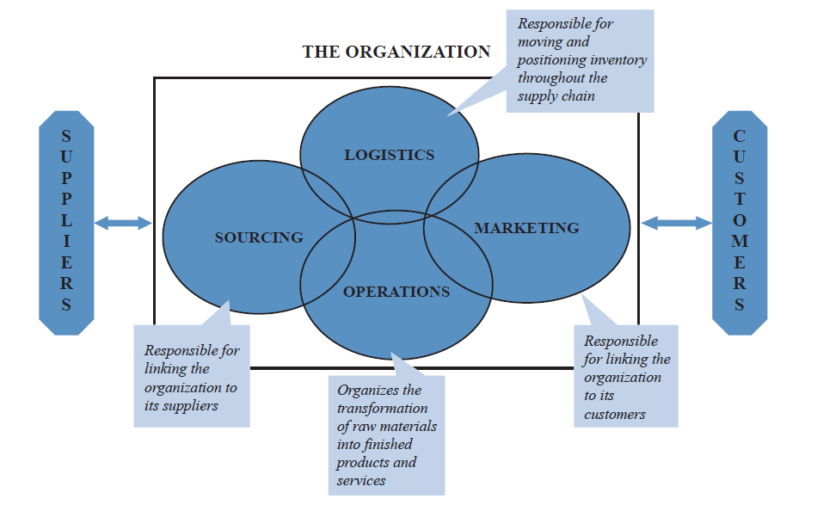
Boundary-Spanning Nature of SCM
(Intra-organisational integration/coordination)
Intra-organisational integration/coordination involves the participation and coordination of activities across different organisational functions, such as sourcing, operations, marketing, and logistics.

Slide 23
Boundary-Spanning Nature of SCM
(Intra-organisational integration/coordination)
Sourcing: Function of the enterprise responsible for linking the organisation to its suppliers and ensuring an efficient supply of materials. Thus, sourcing focuses on the supply side of the organization.
Operation: Function of the enterprise organises the transformation of raw materials into finished products and ensures that the exact products customers want are produced efficiently and cost-effectively.
Marketing: Function of the enterprise is responsible for linking the organisation to its customers and identifying what customers want in products and services. Thus, marketing focuses on the customer side of the organization.
Logistics: Function of the enterprise involve moving and positioning inventory throughout the supply chain, which includes order processing and tracking, inventory management, transportation, warehousing, material handling, and packaging and ensures that the right products are delivered to the right place at the right time.

Slide 24
Boundary-Spanning Nature of SCM
(Cross enterprise integration/coordination)
Cross-enterprise integration/coordination involves connecting several organisations through partnerships, alliances, and collaboration so that the supply chain functions as a single organisation to satisfy the needs of the final customer. Achieving full cross-enterprise integration requires sharing risks and rewards among all the enterprises.

Slide 25
SCM vs. Logistics
SCM: The design and management of flows of products, information, and funds throughout the supply chain. It is about the collaboration between supply chain partners (suppliers, manufacturers, distributors, retailers) in a strategic effort to achieve superior competitiveness.
Logistics: The function of the enterprise involves moving and positioning inventory throughout the supply chain, which includes order processing and tracking, inventory management, transportation, warehousing, material handling, and packaging and ensures that the right products are delivered to the right place at the right time. Without logistics, there would be inventory stock-outs at some locations and too much inventory at others. Thus, Logistics is a function of an enterprise that supports SCM on par with marketing, operations, and sourcing. When the direction of product flow is reversed in the chain, i.e., from customer to retailer/wholesaler/manufacturer, due to defective/damaged or obsolete (out of date), it is termed as Reverse Logistics.
SUPPLIER
Inbound
storage/
Transportation
PRODUCER
Outbound
storage/
Transportation
WAREHOUSE
Transportation
to retailer/
customer
RETAILER
Logistic Function of the Enterprise

Slide 26
SECTION 5

Slide 27

Competitive Supply Chain and its’ characteristics
In the era of globalisation and technological advancement, SCM is treated as a necessary ingredient for successful global competition. It enables companies to significantly reduce the time required to design, process, and deliver products to customers at a lower cost.
Advances in information technology have enabled access to comprehensive data across all components of the supply chain, and improvements in transportation methods have not only led to a reduction in transportation costs but also increased the speed of delivery to multiple locations
RESPONSIVENESS :
Today, customers want shorter lead times, greater flexibility, and greater product choice. In view of this, suppliers and manufacturers always plan to meet customer demands in less time than ever before.
The ability of a supply chain to achieve this level of responsiveness is often described as ‘‘agility,’’ - the ability to move quickly to meet customer demands.
RELIABILITY:
Uncertainty about (i) future demands, (ii) suppliers’ ability to meet deadlines, and (iii) the quality of component materials is a major driver of carrying safety stocks by the companies, resulting in the “Bullwhip effect” and leading to higher costs.
The best way to reduce uncertainty is to increase supply chain reliability by enhancing visibility across all entities in the chain through real-time data sharing and information technology.
RELATIONSHIP MANAGEMENT:
SCM is primarily about managing relationships across complex networks of companies. Competitive supply chains focus on relationship building and collaboration based upon trust, rather than an arms-length adversarial relationship (interactions between independent, unconnected parties focused solely on self-interest, maximising individual gain for the short-term).
The practice of ‘‘single-sourcing’’ improves quality, product innovation, and design while reducing costs and enhancing overall responsiveness.

Slide 28
Trends in SCM
GLOBALIZATION
OUTSOURCING
INFORMATION TECHNOLOGY
BIG DATA ANALYTICS
MASS CUSTOMIZATION AND POSTPONEMENT
SUSTAINABILITY AND GREEN SUPPLY CHAIN

Slide 29

Trends in SCM (Globalization)
GLOBALIZATION:
The integration between the world’s nations, markets, and social and political systems.
Globalisation forces companies, regardless of location or primary market base, to consider the rest of the world in their competitive strategy analysis. A company can develop a product in the United States, manufacture it in India and sell it in Europe.
Companies have benefited from a wider choice of product sources, and consumers have benefited from greater product choice, higher quality, and lower cost.
Challenges:
Movement across borders, and even continents, adds numerous additional costs such as tariffs and extends the length and variability of lead times.
There are time costs due to border delays, costs of transportation, and higher inventory costs due to longer transit times.
There are also significant risks that include political instability, as well as currency fluctuations.

Slide 30
Trends in SCM (Outsourcing)
OUTSOURCING:
Hiring a third party to perform a set of tasks for a fee. Although companies have historically and routinely outsourced certain activities, such as cleaning and record management, they are now outsourcing almost all activities on a much larger scale.
To create superior value for customers by managing their core competencies (abilities/skills) better than competitors, organisations are outsourcing one aspect of the operation, such as shipping, or an entire part of the manufacturing process.
Manufacturers have outsourced software development and product design to engineers in India, accounting firms have outsourced tax preparation to India, and even some hospitals have outsourced the reading of CAT scans to doctors in India and Australia.

Slide 31
Trends in SCM (Information Technology)
INFORMATION TECHNOLOGY:
Technological advances have enabled companies to produce products faster, with better quality, and at a lower cost. Information Technology helps in coordinating among supply chain members.
Internet connects trading partners—customers, buyers, and suppliers—and has enabled e-commerce and the virtual marketplace.
ERP (large software programs) used for planning and coordinating all resources throughout the entire enterprise. They allow data sharing and communication within and outside of the firm, enabling collaborative decision-making.
GPS - a type of wireless technology that uses satellite transmission to communicate exact locations, and helps in logistics. Trucking companies use GPS technology to identify the exact location of their vehicles.
RFID - a type of wireless technology that uses memory chips equipped with tiny radio antennas that can be attached to objects to transmit streams of data, such as product movement, reveal a missing product’s location, or track shipments and their arrival, in a real time basis.

Slide 32
Trends in SCM (Big data Analytics)
BIG DATA: Large data sets (point-of-sale data, RFID data, GPS data, call centre data, Twitter feeds, and consumer blogs) whose size is so large that the quantity can no longer fit into the memory of the computers used for processing. Thus, Big Data encompasses an extensive and diverse collection of data.
ANALYTICS: Applying Math & statistics to the large data sets for analysis. Statistical tools such as Correlation and Regression analysis, used for decades for data analysis, are not suitable for analysing and predicting from Big Data collected from diverse sources.
BIG DATA ANALYTICS: Processes that organisations use to derive value from their big data. Big data analytics using Machine Learning (ML), Artificial Intelligence (AI), and Internet of Things (IOT) to identify and study patterns, correlations and trends within large datasets.
TODAY’S COMPUTING POWERS:
AI & ML (Artificial Intelligence & Machine Learning): Develops algorithms that possess the remarkable ability to learn from data and apply the acquired knowledge to make data-driven predictions/forecasts, such as customer demand, market prediction, with higher accuracy and speed to maximise competitive advantage.
IOT (Internet of Things): a network of physical devices, vehicles, appliances, and other physical objects that are embedded with sensors, software, and network connectivity, like RFID, allowing them to collect and share data. IOT tracks real-time location, monitors storage conditions (environmental conditions), locates goods within the warehouse, and much more.

Slide 33
Trends in SCM (Mass Customisation & Postponement)
In the era of globalisation, companies are continually struggling to reach global markets while providing local customisation, i.e., washing machine companies are providing top-loading machines to the French, front-loading machines to the British, high-speed spins to the Germans, and lower speed spins to the Italians.
To reach diverse geographic areas catering for local tastes and preferences, global companies adopt the strategy of MASS CUSTOMIZATION (customer-oriented and individualised mass production that meets the diverse needs of each customer while maintaining costs comparable to those of standard mass-produced products). For this purpose, companies POSTPONE (delay) the completion of the final product to the last possible moment till local demands are known with greater certainty.
To achieve the strategy of Mass Customisation, the company seek standardised parts, components and modules, and then, through flexible manufacturing and logistics, provides specific product demands at each market.

Slide 34
Trends in SCM (Sustainability and Green Supply Chain)
Integrating environmental, social, and financial considerations into every stage of the product life cycle, i.e., from designing, sourcing, and manufacturing to logistics and disposal.
Sustainability Strategy:
Using environmentally friendly inputs and creating outputs that can be recycled and do not contaminate the environment by emitting GHGs.
Using renewable energy and energy-efficient technologies in the production process.
Using fuel-efficient vehicles.
Reducing the amount of cardboard used for packaging and designing ‘‘smart packages’’ to save money.
Filling trucks as full as possible, rather than moving half-empty trucks during the transportation of goods.

Slide 35
Next:
Supply Chain Strategy

